Slide 1

PaceFinity
Aidan Farrell (af71644n)
Hemanvitha Mylapalli (hm18290n)
Indeevara Tadikonda (it49412n)

Slide 2
Agenda
Idea Proposal + Project Statement
02. Personas
03. App Logo
04. Project Design
05. Product Backlog
06. Metrics
07. App Screenshots

Slide 3
<01>
+
Idea Proposal
+
Project Statement

Slide 4
Idea proposal
Our objective is to assist Pace University students in comprehending how financial aid affects the amount they need to pay by performing personalized calculations based on their inputs. This is particularly crucial because the students who rely on financial aid the most should have a thorough understanding of it. Our primary focus is to provide comprehensive information on payments that may not be addressed by standard calculators and information sources.
― Irene M. Pepperberg

Slide 5
Project Statement
Pacefinity is a multipurpose tool that centralizes all sorts of information about finances at Pace. It has a financial aid calculator built in, it will also have information about scholarships and will link to external resources depending on what the student needs. We also want to add a feature that lets the student figure out what the price of each class/cost will be to be able to break down their cost of a semester down to the class just so they know exactly what they will be paying.

Slide 6
<02>
+
Personas

Slide 7
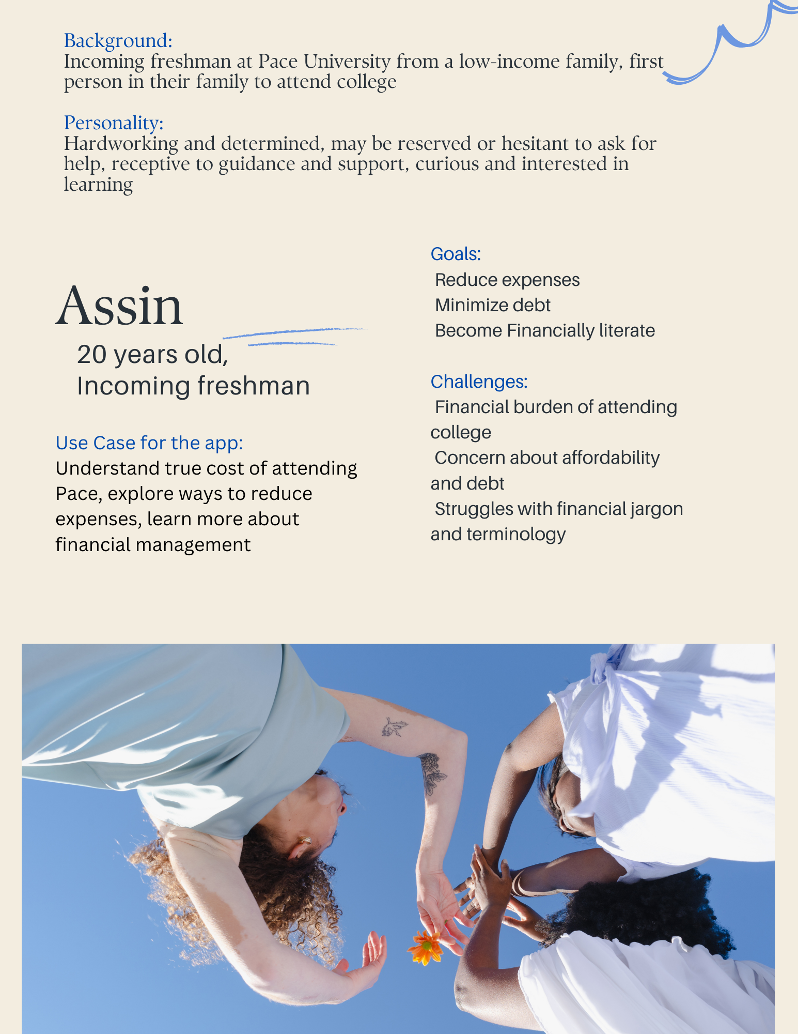
Persona 1 1

Slide 8
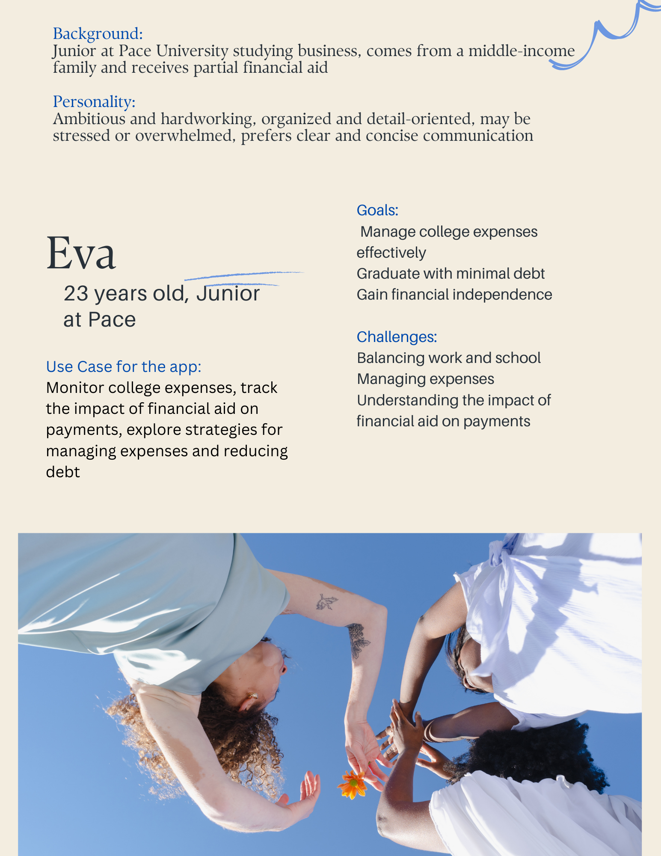
Persona 2 1

Slide 9

Persona 3 1

Slide 10
<03>
+
App Logo

Slide 11

The name of the app is a combination of Pace and a short form of Financial ability. The logo represents a graduation hat with the dollar sign.

Slide 12
<04>
+
Project Design

Slide 13
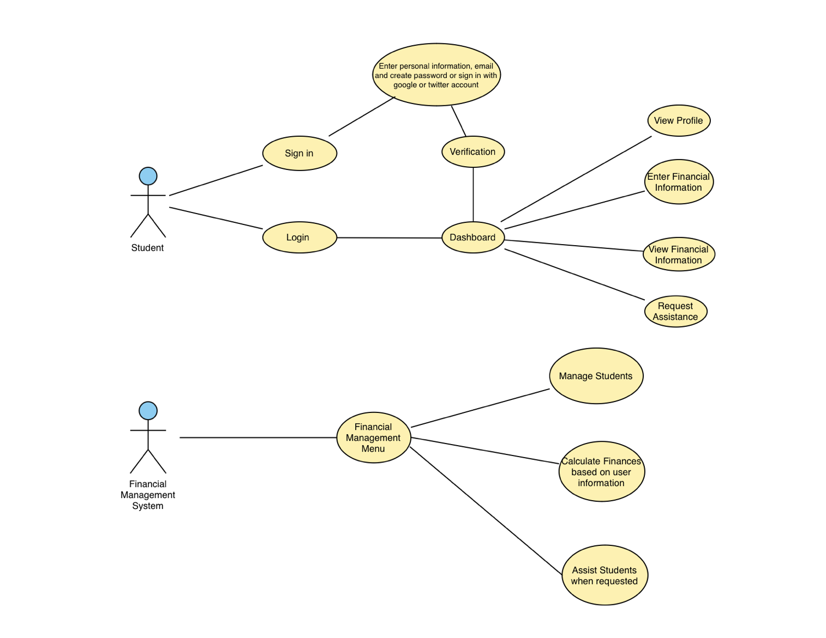
Use Case Diagram 1

Slide 14
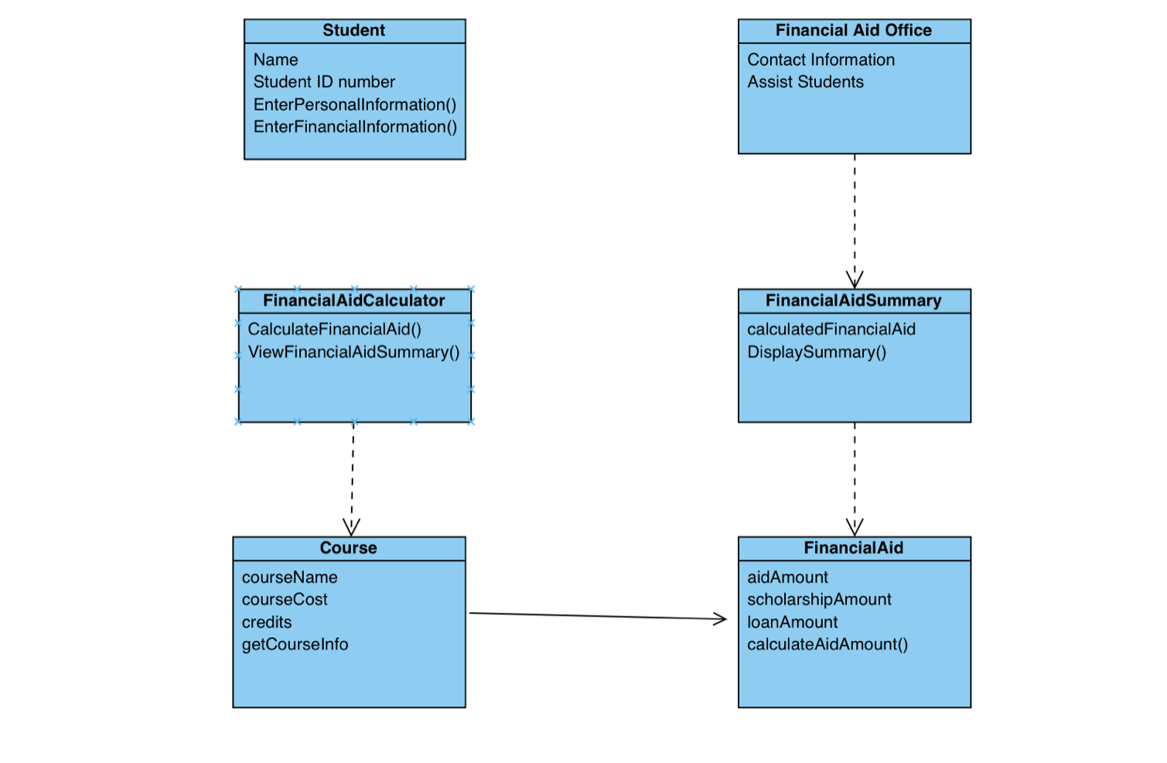
Class Diagram 1

Slide 15
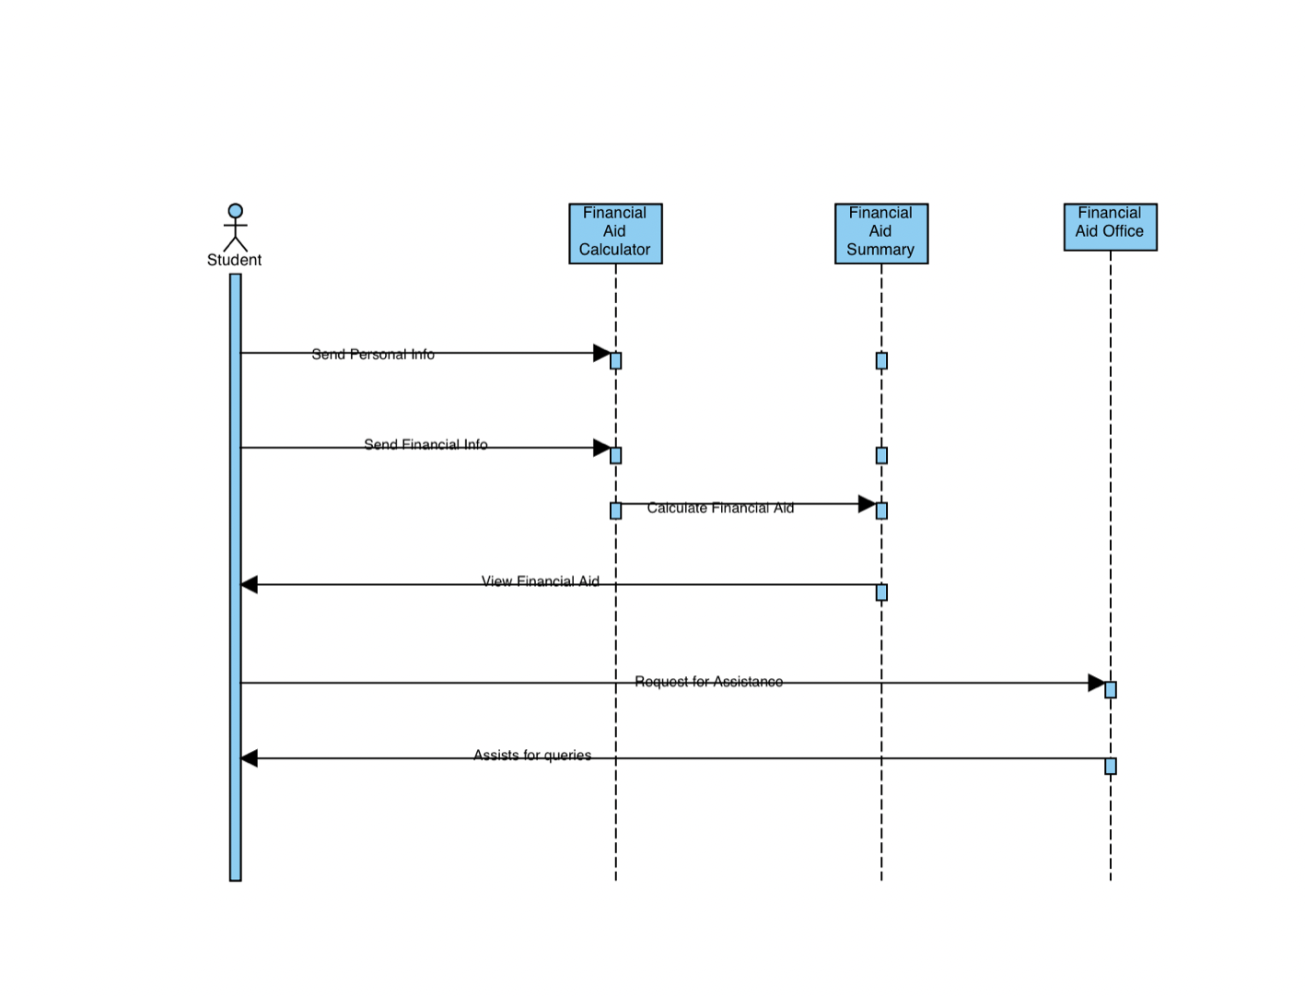
Sequence Diagram 1

Slide 16
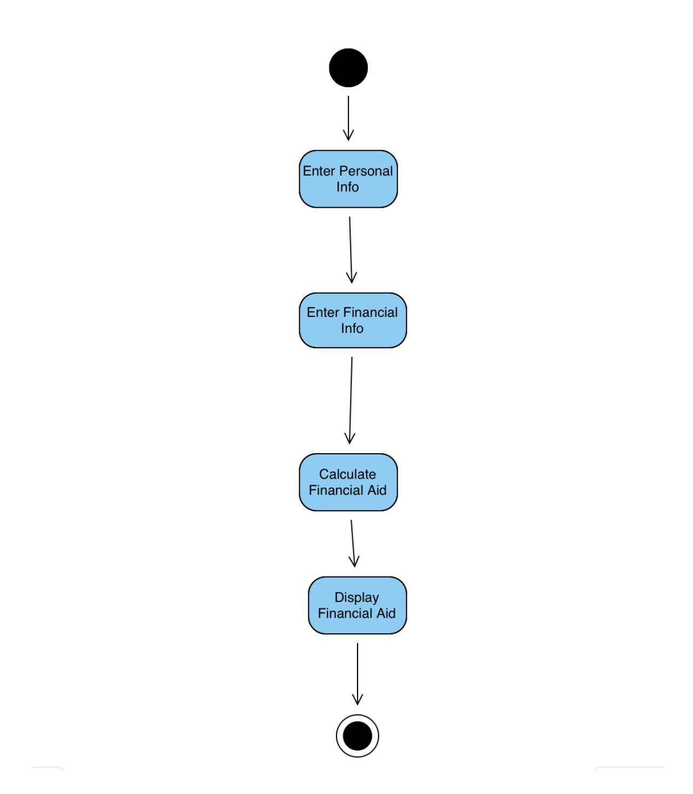
Activity Diagram 1

Slide 17
<05>
+
Product Backlog

Slide 18
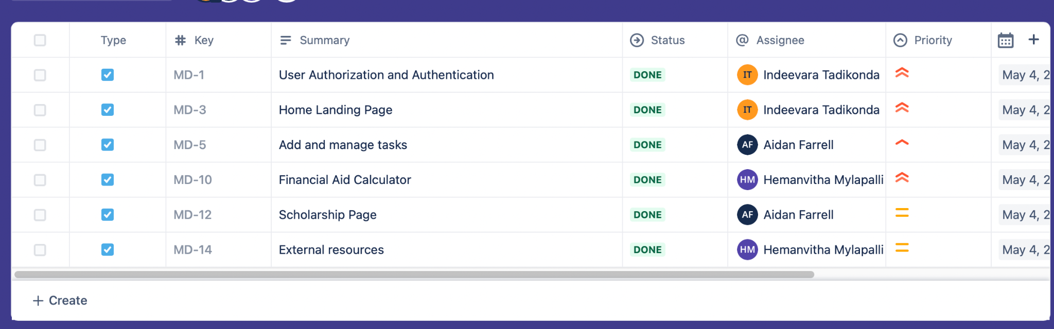
Product Backlog

Slide 19
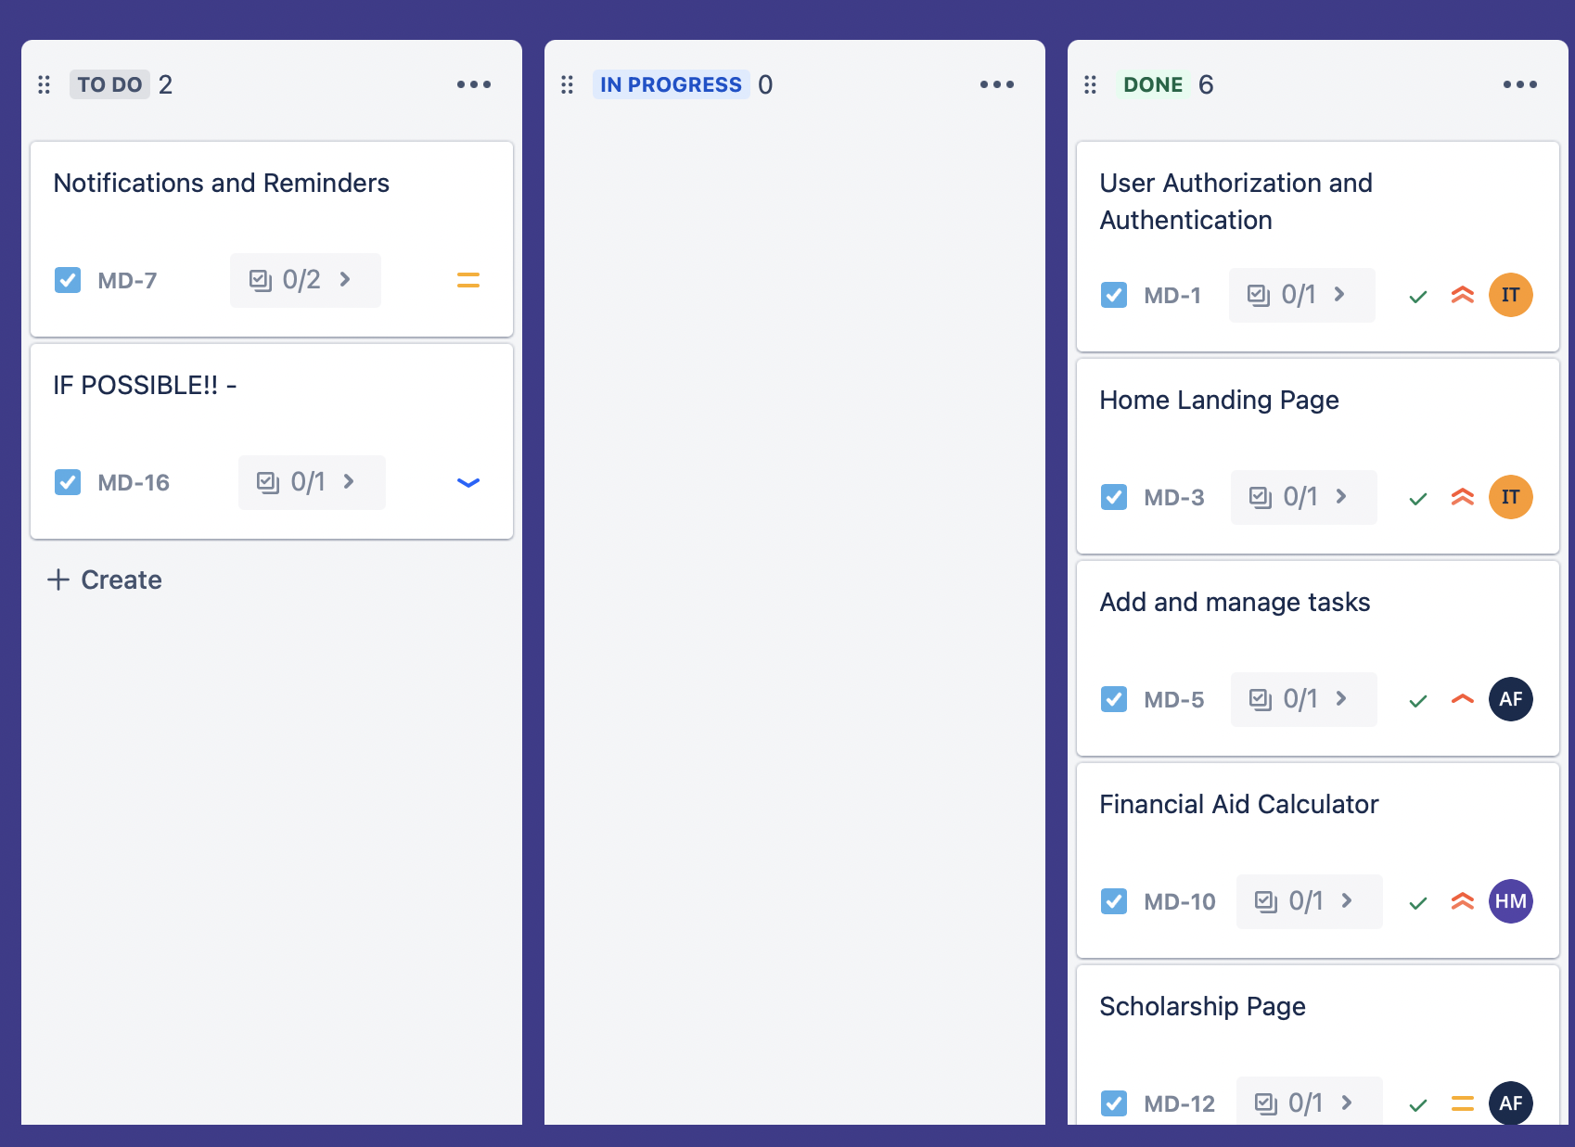
Product Backlog

Slide 20
<06>
+
Metrics

Slide 21
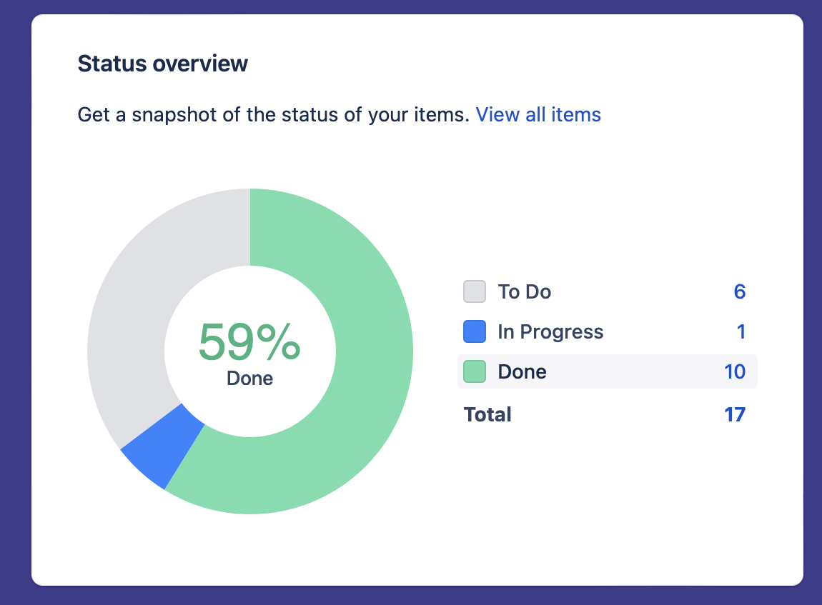
Metrics

Slide 22
<07>
+
App Screenshots

Slide 23
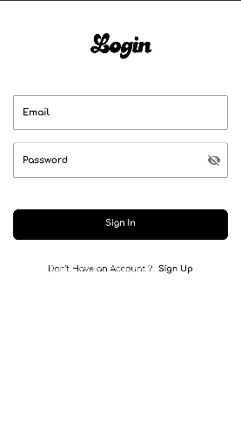
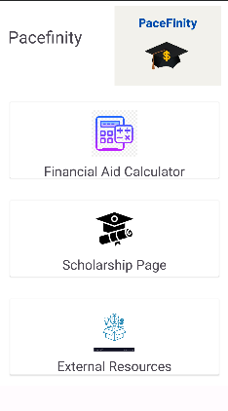
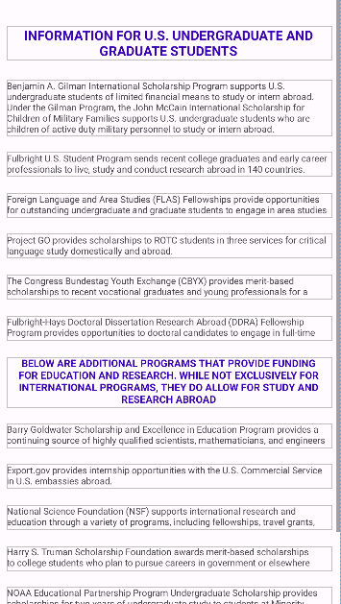
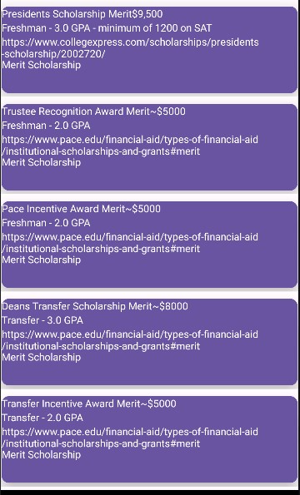
App Screenshots

Slide 24
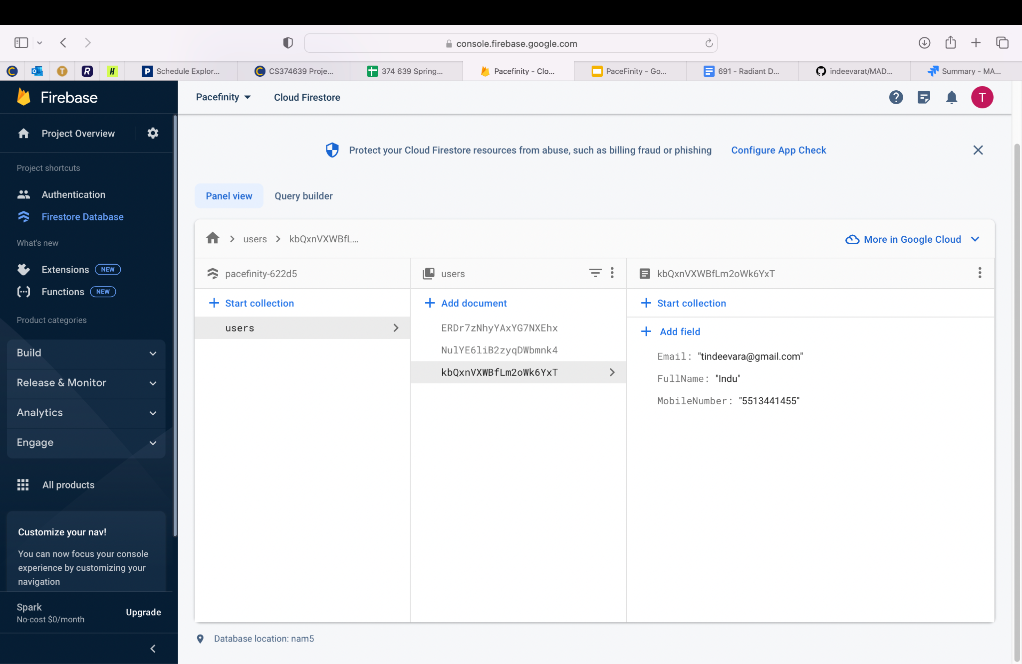
App Screenshots

Slide 25
Thank you!

